Slide 1
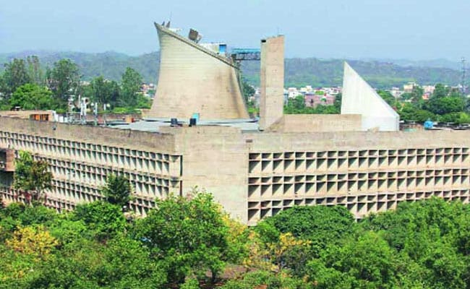
National e-Vidhan Application (NeVA )
Haryana Legislative Assembly, Chandigarh

Slide 2







Vidhan Sabha Challenges NeVA implementation
Excess Paper Work and huge paper wastage
Hon`ble Governor
Hon`ble Speaker / Deputy Speaker
Hon`ble Chief Minister / Minister(s)
Impacted Stakeholders
Lack of information
Delay
Members of Legislative Assembly (MLA)
Secretary, Vidhan Sabha
Administrative Secretaries
Employees of Vidhan Sabha Secretariat
Lack of
Accountability
Government Departments and Undertakings / Corporations
AG office
Difficulty in maintaining up to date Records
Repetitive
efforts
Citizens

Slide 3
NeVA Journey in Haryana Legislative Assembly
Constitution of SPMU & High Level Apex Committee
(13.08.2020)
Study Visit to Himachal, Arunachal Pradesh Assemblies and Bihar Council.
(9.12.21-14.12.21)
Preparation of DPR
26.02.2021 to 11.07.2021
Approval of DPR By SPMU & High level Apex Committee
(12.07.2021)
Tripartite
MOU
(25.02.2021)
Setup of NeVA SeVA Kendra (NSK) (09.02.2022)
Release of the Funds by MoPA
(23.02.2022)
Approval of DPR at Central Level by MoPA (23.12.2021)
Hardware
Procurement
August 2022
NeVA Trainings for Members
21-22.07.2022
Manpower Deployment
(January, 2023)
Go Live Session
on NEVA
( 8th August 2022)

Slide 4

Benefits accrued
Key Changes after NeVA implementation:
Several tons of the paper have been saved
No need to visit the member to Assembly to submit their Question, Notices/Motions.
Questions are being made visible to concerned departments for their knowledge just after the initial approval.
Right information to right person at right time with single click .
The optimum usage of manpower and machinery for information distribution and update has been reduced to negligible as no physical paper is being shared/distributed.
Easy & Timely information access
Online-centralized House related information access to MLA`s Ministers and Assembly staff and Govt. Deptt. & public.
Increased visibility
Extensive reports for multiple processes ensure complete visibility and better accountability
Single Digital
Platform for all
Portal & Mobile App for MLA`s, Ministers and Assembly staff and Government Departments.
Public Information through NeVA
All the information will be made available in public domain through NEVA Portal immediately after laid and passed by House.
Paperless House
Automated workflows and use of mobile, tablets etc helps assemblies achieve paperless transaction of the legislative business
Enhanced
collaboration
Electronic voting and real-time updates on Questions, Notices/Motions, Bills, Proceedings etc.
4

Slide 5
Key Steps/Decisions to Complete the Project in limited timeline & reduced the total cost to 70%
Active Support of Hon`ble Speaker, Hon`ble Chief Minister, Hon`ble Leader of Opposition and all the Members of Haryana Assembly
Active Support of Chief Secretary, Haryana.
14 consecutive joint meeting of High Level Apex Committee and SPMU under the Chairmanship of Hon`ble Speaker.
To Speed-up the project procurement, a dedicated Technical Committee was constituted with technical representatives of NIC, NICSI, Haryana Assembly and State IT Department under the Chairmanship of Secretary, Haryana Vidhan Sabha, who did processing Daily meetings for 7 days to prepare Technical specifications for the procurement.
In parallel of Hardware procurement, the NeVA trainings were conducted for the Hon`ble Members, Nodal Officers of NeVA and Vidhan Sabha Secretariat Staff.
August, 2022 (First Session) was conducted with the help of technical manpower provided by HARTRON and NIC in both the modes – online/offline.
70% paper was reduced in second session held in December, 2022.
Third Session i.e Budget Session held in February, 2023 was completely digital and there was no single paper were circulated in the House of Haryana Assembly during session days.
Existing infrastructure was also utilized while implementation and processing of the NeVA project to reduce the project cost.
For the support of Members, IT Technical resources were deputed in each row of the House during session days.
From all above key steps the project was successfully implemented in 70% cost and 7 months timeline.

Slide 6
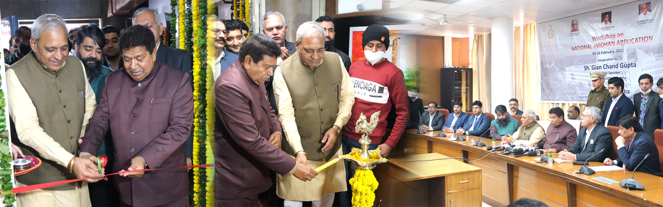
Inauguration of Neva Seva Kendra for Training
Inauguration of Training center –NeVA Seva Kendra & 2 –day Workshop of the National e-Vidhan Application by Hon'ble Speaker Gian Chand Gupta and Shri Ranbir Gangwa, Hon`ble Deputy Speaker, Haryana Legislative Assembly on 9 - 10 Feb 2022.

Slide 7
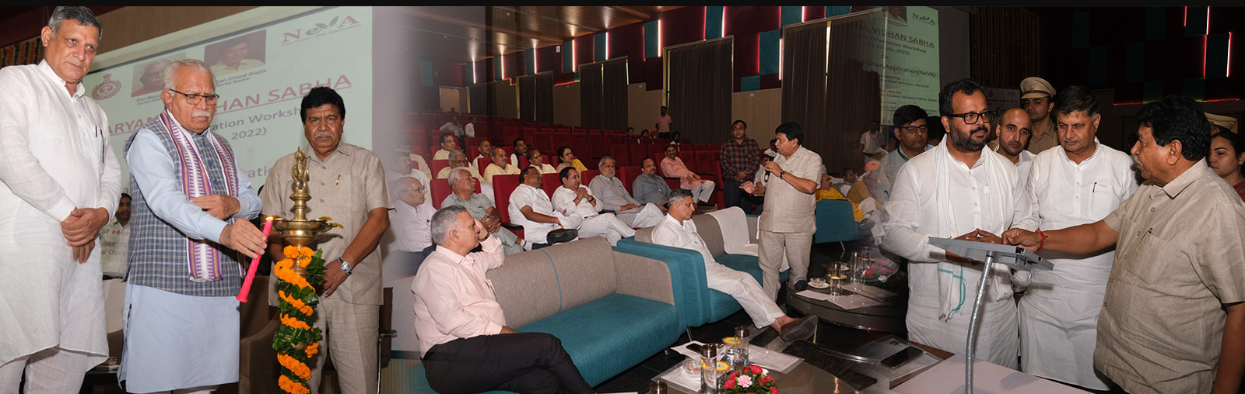
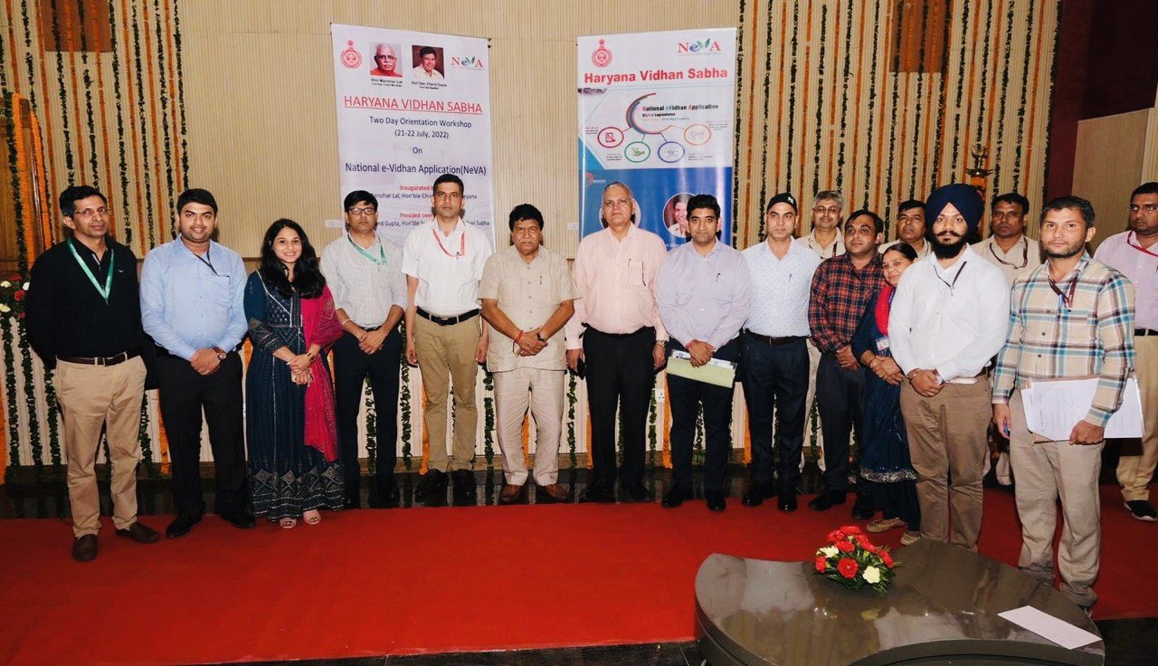
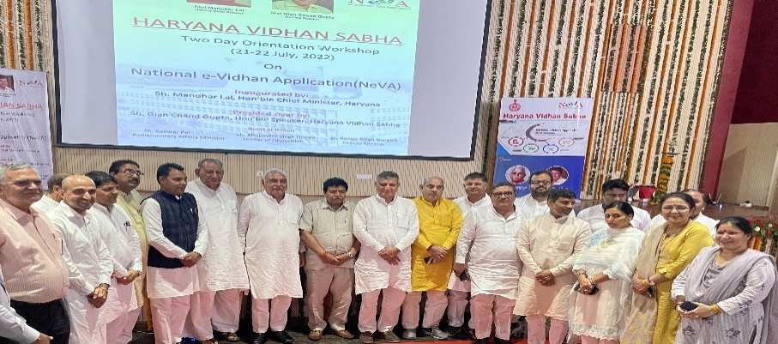
Orientation Workshop by MoPA
Inauguration of Two-days Orientation Workshop on National E-Vidhan Application (NeVA) for Hon`ble Members and Departmental Nodal Officers on 21-22 July, 2022 by Hon`ble Speaker Sh. Gian Chand Gupta.

Slide 8
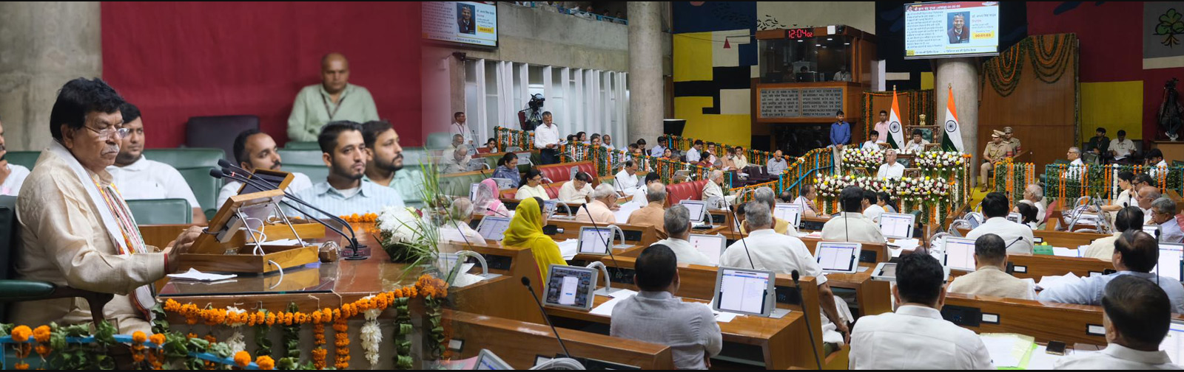
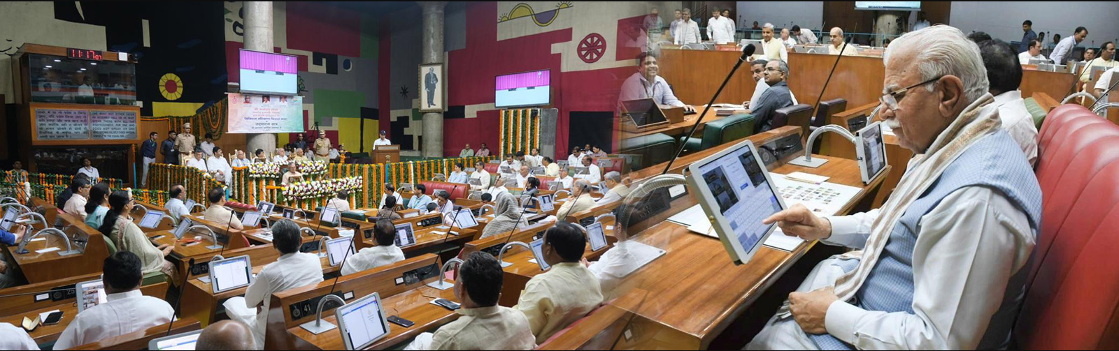
NeVA Launched on 08.08.2022 by Hon'ble Chief Minister Sh. Manohar Lal & Hon`ble Speaker Sh. Gian Chand Gupta
Hon'ble CM of Haryana Sh. Manohar Lal Khattar launched the National e-Vidhan Application on 08.08.22 for digital transaction of first session of Haryana Vidhan Sabha Assembly in auspicious presence of Sh. Gian Chand Gupta Hon'ble Speaker, Sh. Ranbir Gangwa, Hon'ble Deputy Speaker, Sh. Dushyant Chautala Deputy Chief Minister, Chaudhary Bhupinder Singh Hooda, Hon'ble Leader of Opposition.

Slide 9
NeVA Modules Successfully implementation in Haryana Assembly
Master Data Module
Member – Minister Module
House centric application (controller, e-book, display),
List of Business,
Paper Laid Module,
Department Module,
Public portal,
Questions,
Notices/ Motions
Bills modules
All the above mentioned modules have been successfully implemented with its entire online flow and in running state.

Slide 10
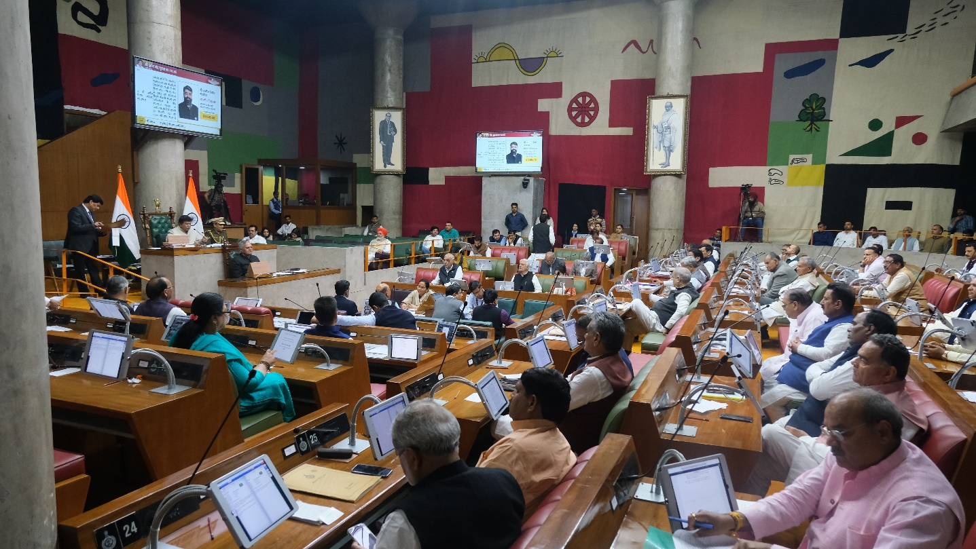
Digital Transaction of all the Legislative Business through NeVA Portal
Key Portal Features:
Single Point Interface for Assembly Staff, Govt Departments, Assembly Members and Public
Role Based process flow
Member centric Mobile App and Portal
Digital House
Assembly Video &
Digital Library
Digital Reports

Slide 11
Transaction at a glance through NeVA

Slide 12

Message from Sh. Gian Chand Gupta, Hon’ble Speaker

Slide 13
Feedback / Suggestion on NeVA
Challenges:
Stability of the existing Application Modules – Due to the ongoing development work, the system application module working got affected. Also in addition to that some of the technical resources of the Application server need to be increased to enhance the stability of the application /portal with multiple concurrence connections. At present with 2-3 simultaneous logins, the system start showing errors.
In time Resolutions of Technical New Requirements/Issues/Queries – Due to the limitation of the technical support manpower at MoPA there is delay in resolution of the technical issues/queries, which should be resolved in timely fashion as sometimes it becomes critical especially during the session days.
Dedicated NeVA Helpdesk at MoPA – There should be a helpdesk with escalation matrix need to be setup who will acknowledge all the Telephonic/email communication of Assemblies and Councils at MoPA end.
Flexibility in Fund Utilization and Technical Manpower – The DPR is being approved on the based of NEVA project Guidelines & PIB of 2020. While the rates of IT equipment’s are drastically increased after the CORONA. Due to the item wise cost approval by CPMU state have struggle at the time of Percurrent of Hardware and match the item wise cost. The Project guidelines and PIB document should be revised regularly and little bit flexibility should be provided to state to utilize the funds under approved categories by CPMU. Same with the case of manpower, it is almost impossible to recruit the technical resources under the existing technical manpower qualification, experience in approved cost rates.
Clarity on National Grid – There are multiple portals/apps are being pushed from Lok Sabha/Rajya Sabha and Ministry of Parliamentary Affairs like NeVA, National Grid etc. As, Haryana Assembly has already adopted the National e-Vidhan Application (NeVA) of Ministry of Parliamentary Affairs, Government of India which is centralized unique portal for all the legislative Assemblies and Councils for all of their Legislative Business. In addition to that this Secretariat have official website on which all the proceedings and other legislative business of this Assembly is updated. In this scenario, adoption of another portal or app for the same purpose of proceedings may be other legislative business may leads to duplicity of the work and management of the different portals/website for the same purpose is also not recommended. Therefore, a clarity may be provided on National Grid with the purpose and benefits before its implementation.
Suggestions - There should be appreciation/recognition program need to be organised for those assemblies/councils who come forwarded and implemented the Nation al e-Vidhan successfully with their special achievements like very short time implementation, saving of money while implementation etc. It will not only boost the morale of implementing state but also encourage others legislative Assemblies/councils to onboard NeVA.

Slide 14
Thank you
IT-NeVA Cell
Haryana Vidhan Sabha Secretariat

