Slide 1
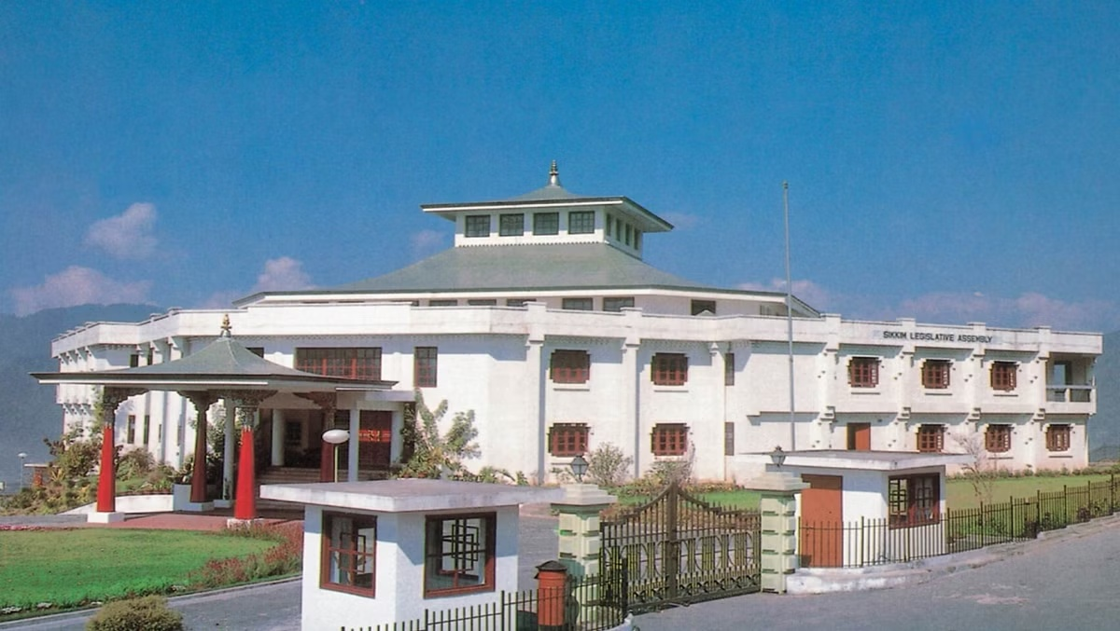
NeVA Implementation in Sikkim Legislative Assembly

Slide 2
INTRODUCTION
First phase of training was held on 15th Dec 2020.
On 10th Feb 2021, MOU & TRIPARTITE agreement was signed for NeVA implementation in Sikkim Legislative Assembly.
A State Project Management Unit cum NeVA implementation committee was formed on 22nd Feb 2021.
DIT designated as nodal department for project implementation in collaboration with NIC Sikkim on 11th June 2021
Selection of Vendor was done accordingly.

Slide 3
PRESENT STATUS
Infrastructure Setup by vendor for running NeVA project
Formulation of NeVA core team
Virtual Training for NeVA team
Master Data Entry
Module wise training
User Management(creation of user accounts for various sections of SLAS)

Slide 4
IMPLEMENTED MODULES
Currently active modules:
Super admin
Admin
User Management
List of Business Module
Question Module
Digital House Application (E-Book, Business Controller, Display Unit)
Public Portal
E-Laying

Slide 5
BENEFITS
Members were able to view List of Business and Questions through NeVA E-Book.
We were able to display live going Agenda, Questions and Speaking Time of Members through Display Unit Module.
Sikkim Legislative Assembly staffs were able to save their time using this Question processing Module (NeVA Application).
NeVA Digital House Module a digital e-Book format accessible through member's login on touch-screen device installed at Member's Desks.
We were able to lay all the Questions and List of Business to public through public Portal of NeVA.

Slide 6
CHALLENGES
Overall implementation of project delayed due to COVID-19
Short time frame between training and going live.
Need of video wall and dedicated control room.
Robotic cameras and mixing devices required for High Definition video streaming of live sessions
Assigning users for dedicated modules.
Getting Hon’ble Members of house comfortable for using e-books.

Slide 7
ACHIEVEMENTS
After the first live session, we observed that members of the House were more interested in viewing questions and LOB digitally
Live Streaming the Budget Speech through NeVA
Positive feedback from Hon’ble Chief Minister, Hon’ble Speaker and Hon’ble members on overall usefulness of NeVA
Positive feedback from public on seeing the live telecast and budget book in public portal

Slide 8
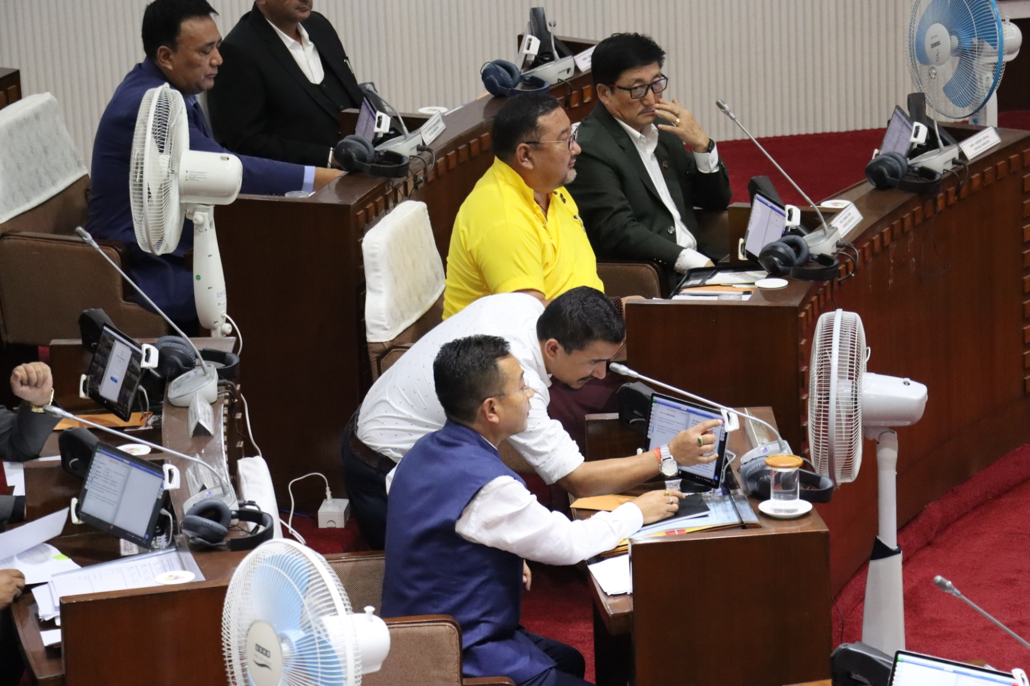
Photographs

Slide 9
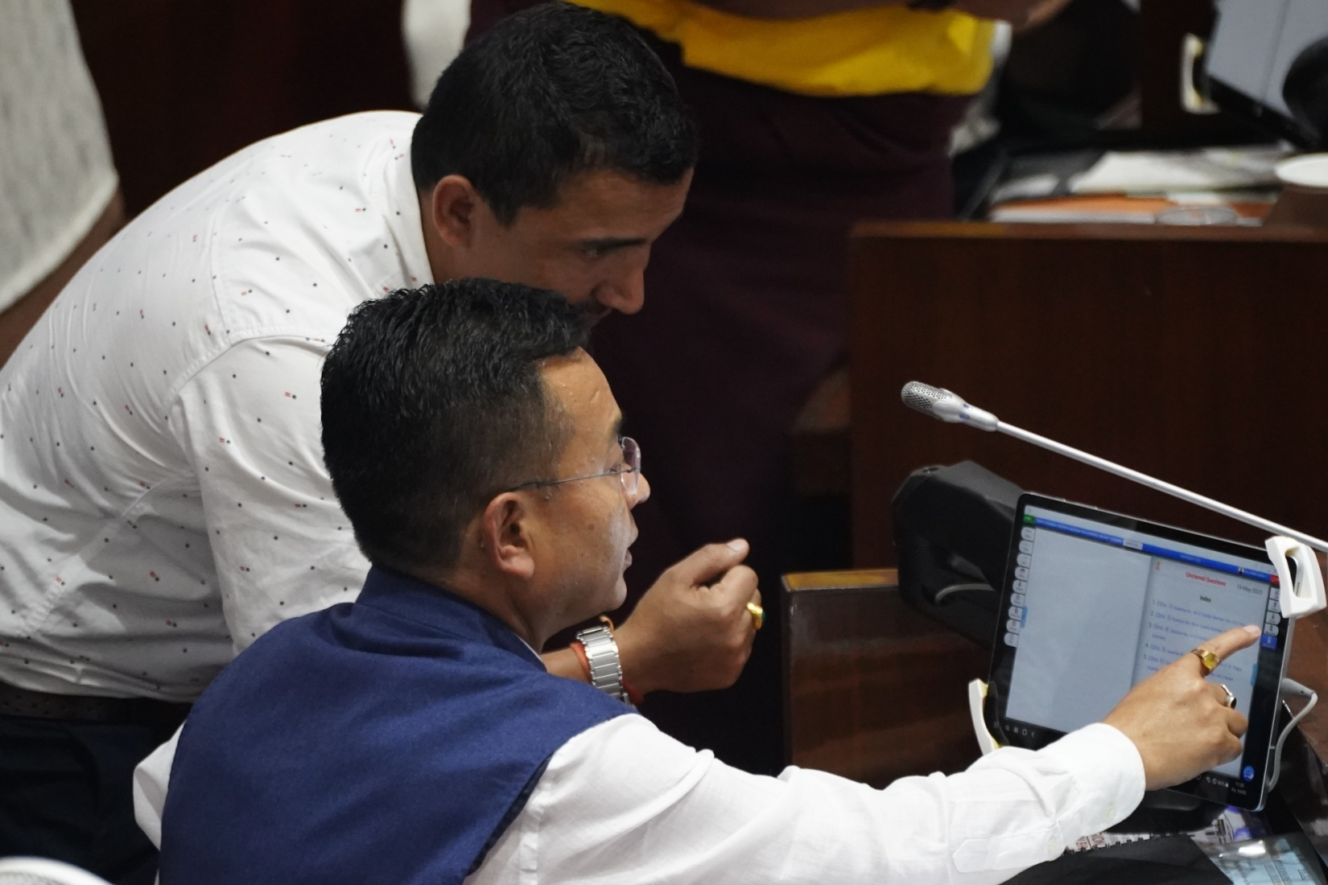
Photographs

Slide 10
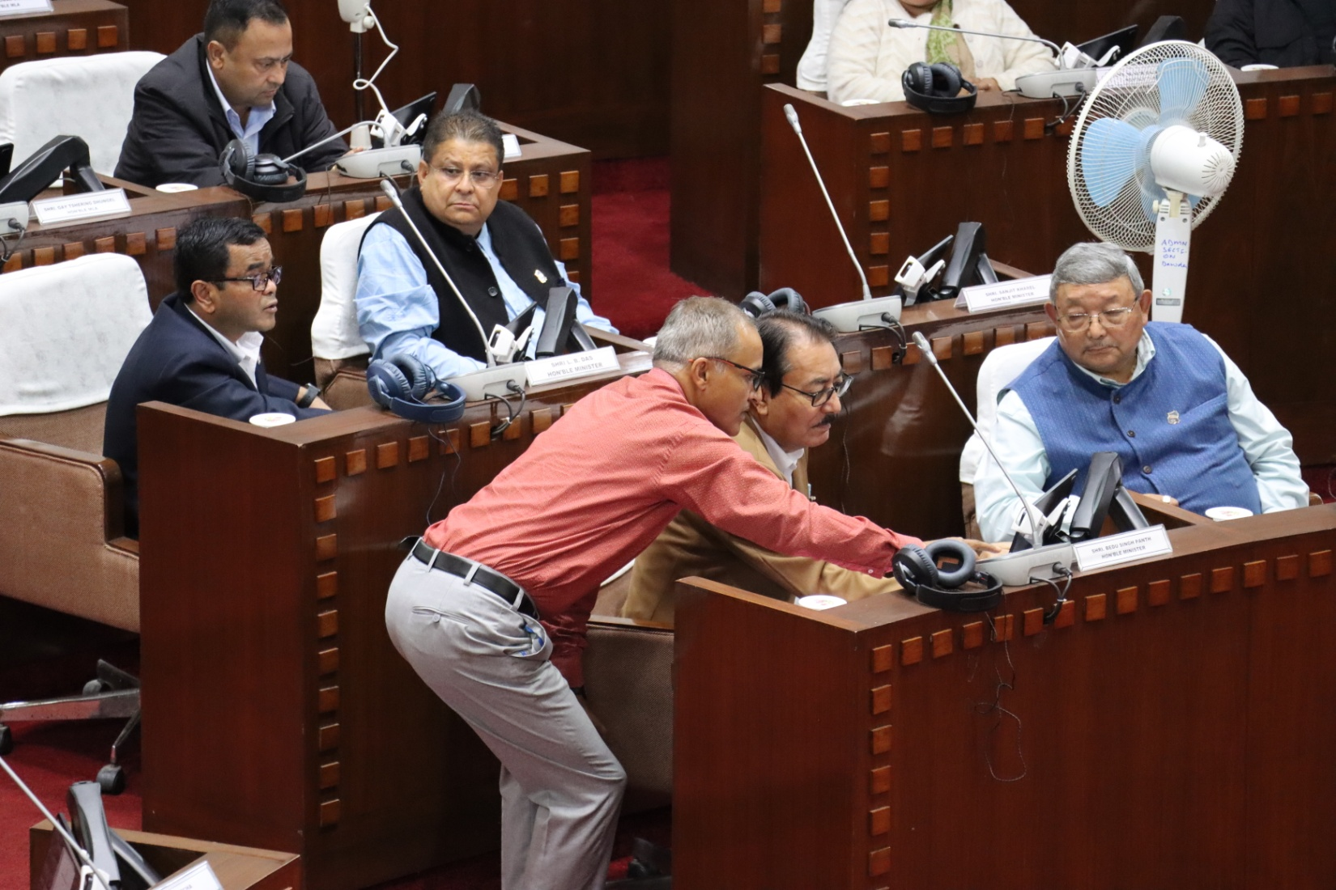
Photographs

Slide 11
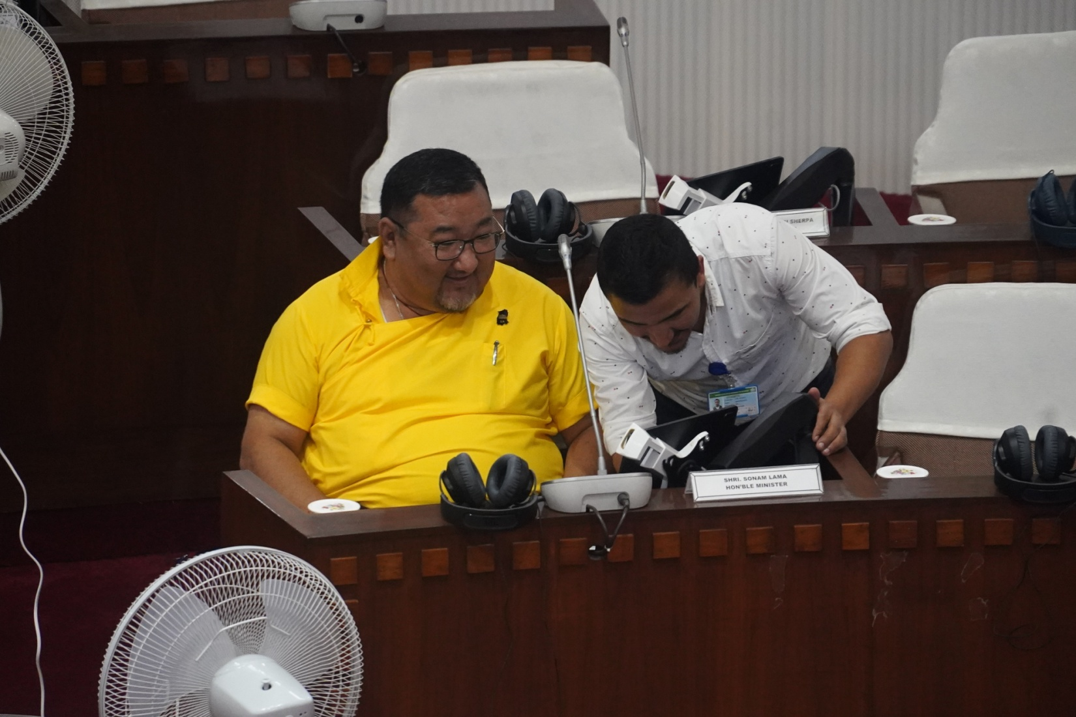
Photographs

Slide 12
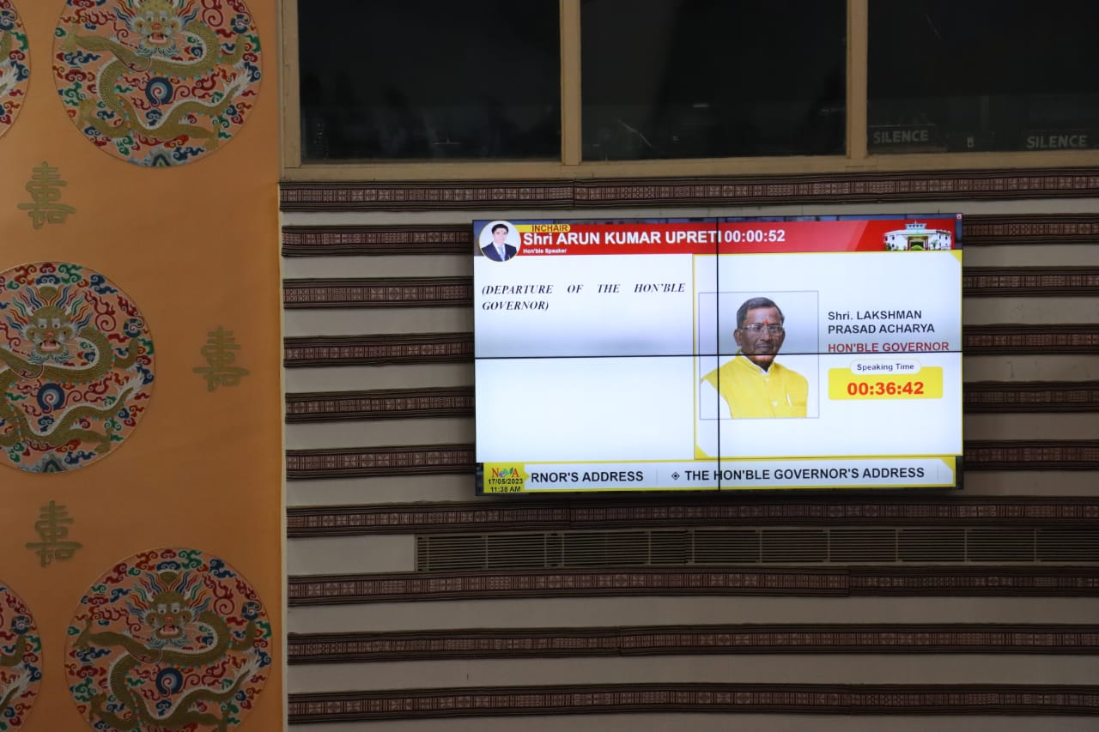
Photographs

Slide 13
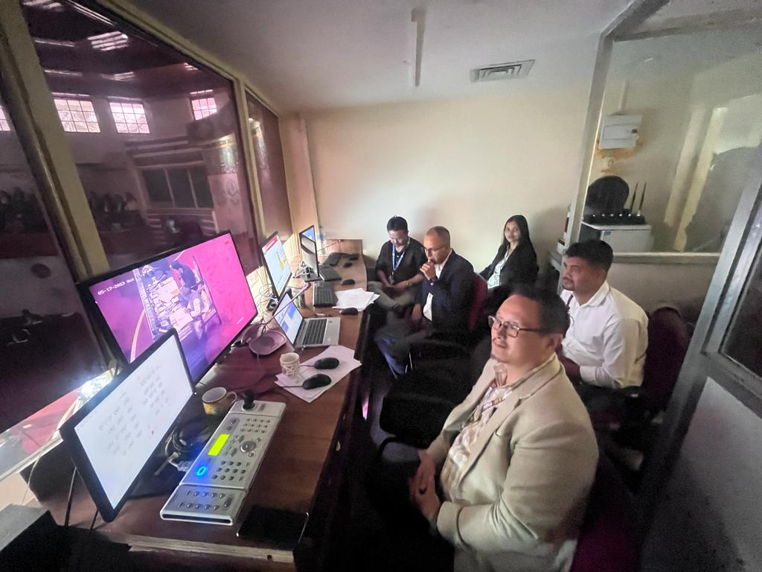
Photographs

Slide 14
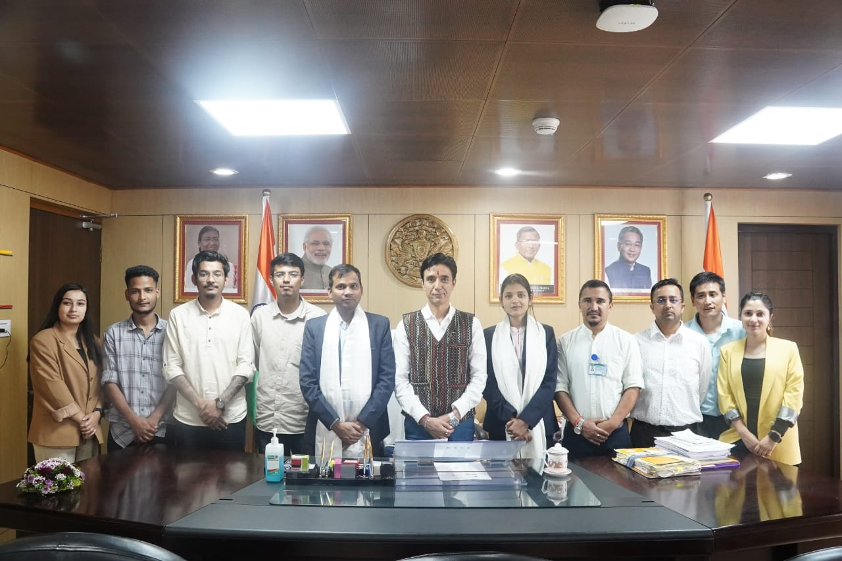
Photographs

Slide 15
Thank You

