Slide 1
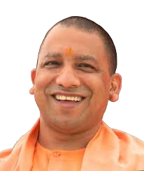

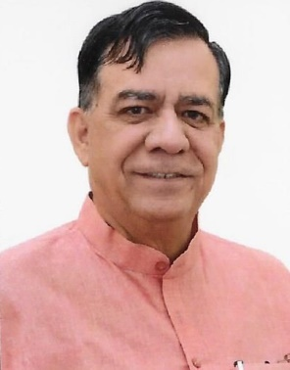

in
Uttar Pradesh Legislative Assembly

Slide 2
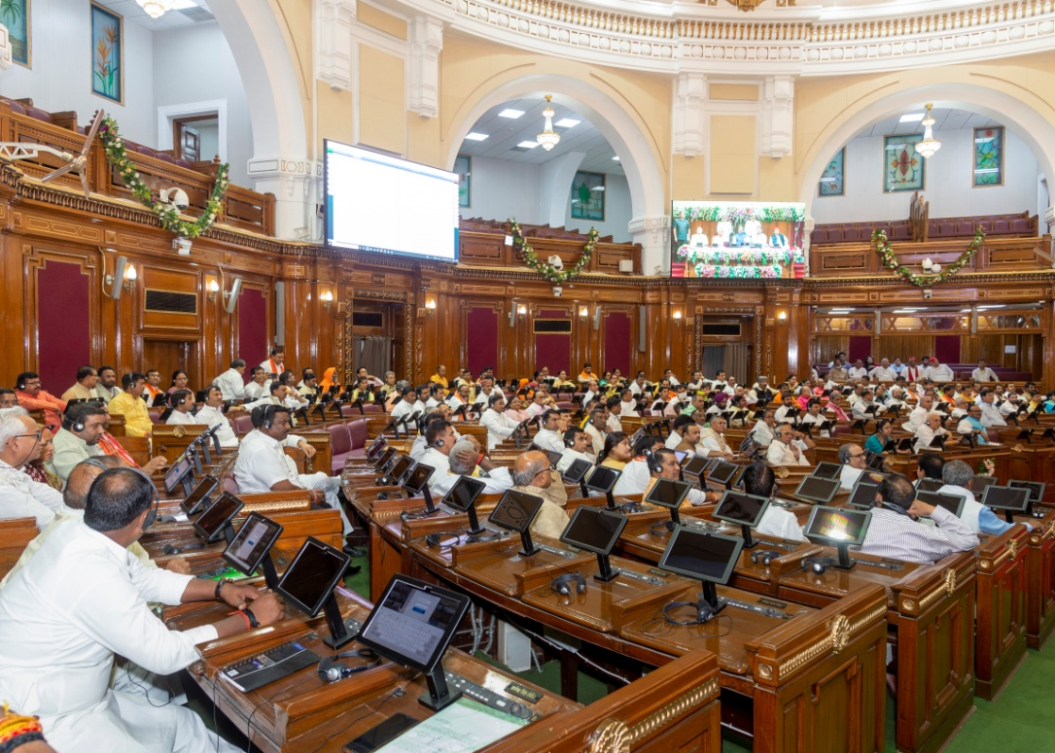
Adoption of NeVA
Uttar Pradesh Legislative Assembly adopted NeVA with the approval of SPMU on 14th March 2022.
A tripartite MoU amongst MoPA(GoI), Department of Parliamentary Affairs(GoUP) and UPLA was signed on 08th April 2021.
First Session of the 18th Legislative Assembly on 23rd May 2022 was conducted Digitally on NeVA platform.

Slide 3
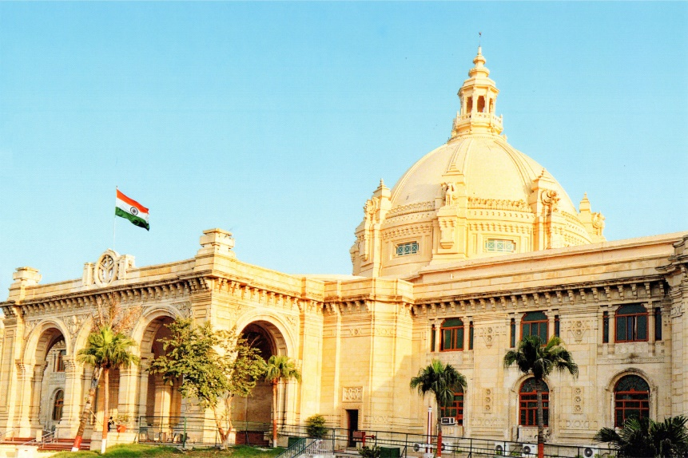
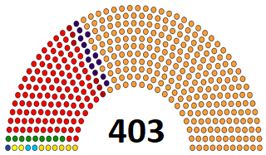
Digital Facility in UPLA before NeVA
UPLA has already achieved several goals as mentioned in NeVA DPR before the actual implementation of NeVA.
  UPLA created Vidhan Sabha Online Prasnottar Pranali (VSOPP) in 2016 for online Questions & Answer submission.
  Uttar Pradesh Legislative Assembly website has been transformed into a Dynamic website for easy data flow.
  Live Streaming of House Proceedings on Digital Platform.
                contd…

Slide 4
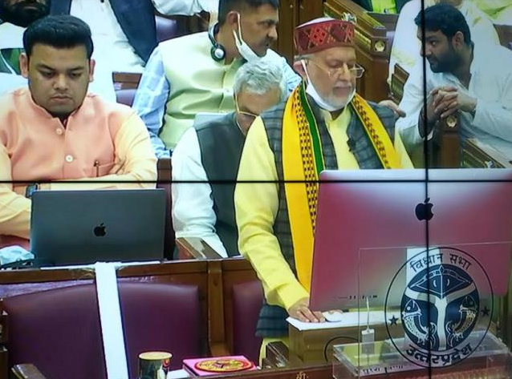
  Digital Archiving of House Proceedings.
  Conducting house via “e-Presence”(video conference) for members.
  Paperless Budget laying was introduced on 22nd February, 2021.
  Display of Agenda on MLA Portal/Official website/Large size screen in the House.

Slide 5
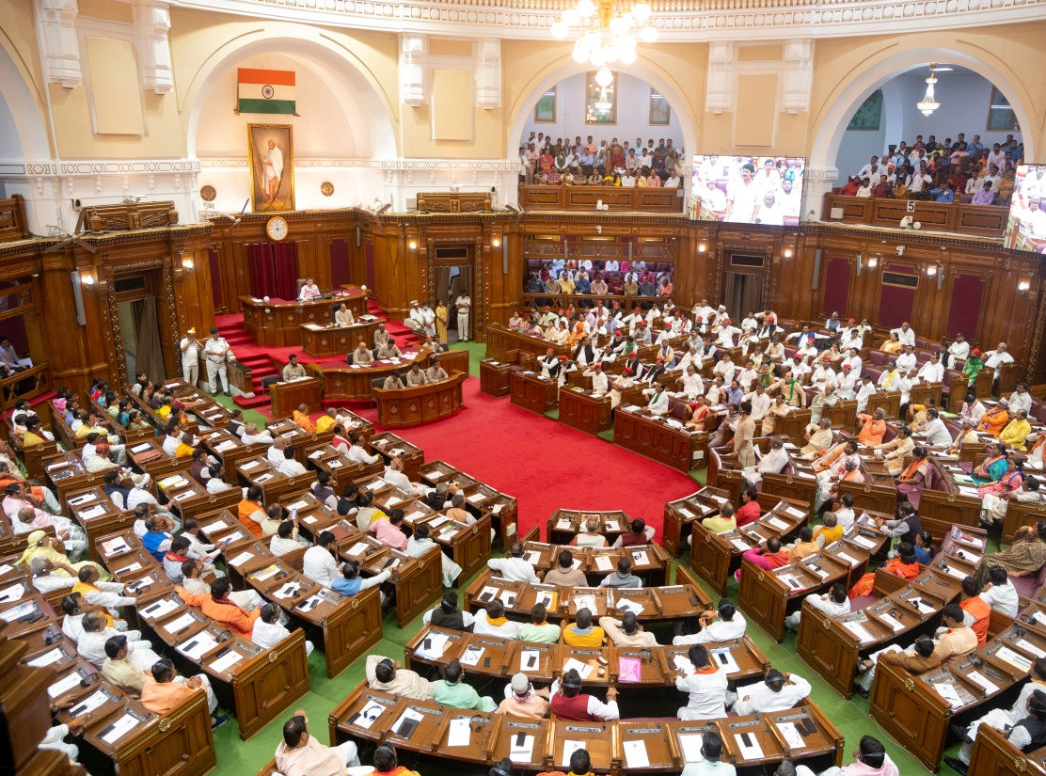
Challenges in implementation of e-Vidhan
Uttar Pradesh Vidhan Sabha Building is almost hundred years old.
Main Mandap has limited space considering the strength of house.
379 seats were available against the required capacity for 403 members.
35 seats were created to allocate specific seat to every Member of the House and Ministers who are member of Vidhan Parishad.
Technical gadgets installation on each desk was a complicated task considering the space constraints especially in last three rows of the house where there is no desk facility.

Slide 6
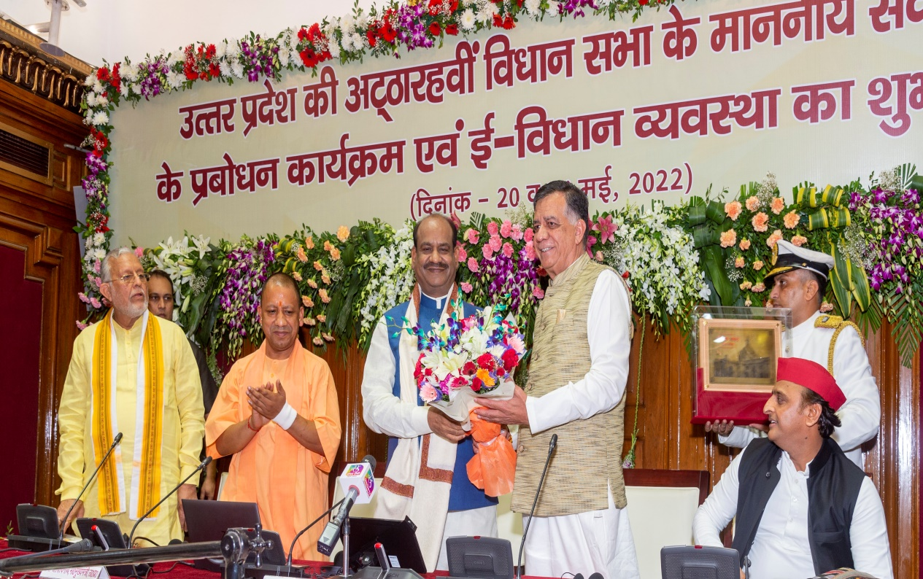
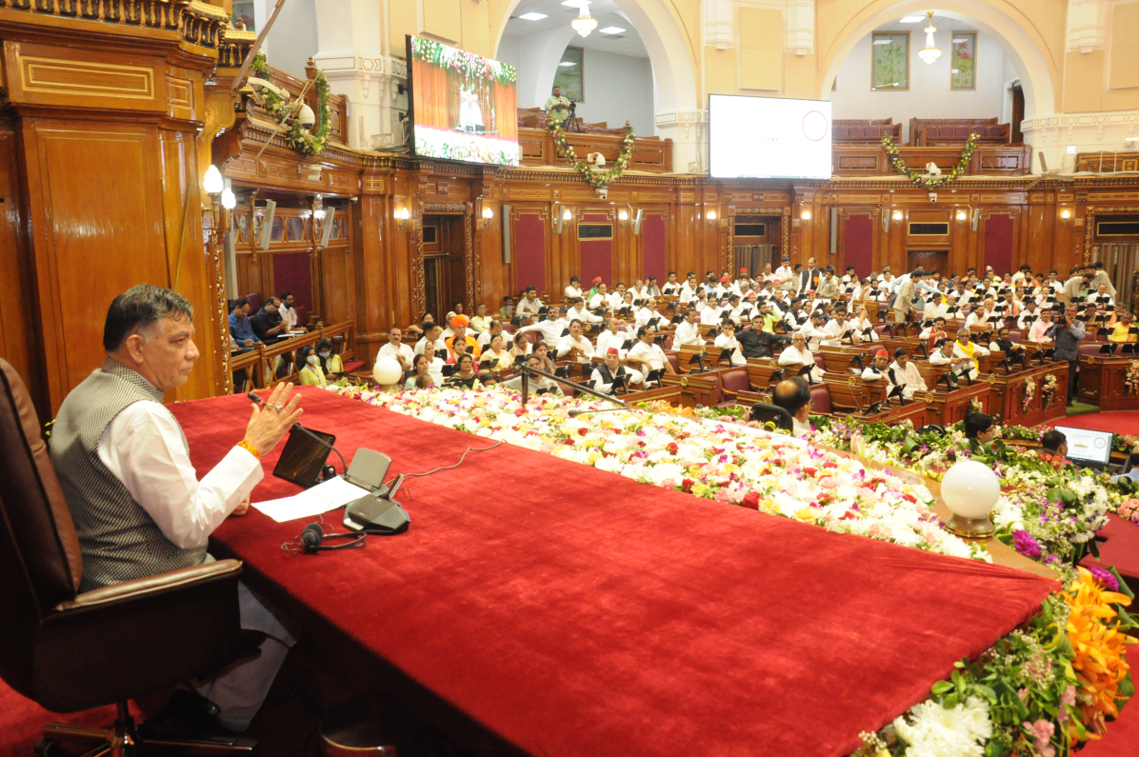
Inauguration of e-Vidhan, Orientation & Training
e-Vidhan in Uttar Pradesh Legislative Assembly was Inaugurated on 20th May 2022 by Shri Om Birla, Hon’ble Speaker Lok Sabha.
Training of Hon’ble Members was conducted for two days on 20th to 21st May 2022.

Slide 7
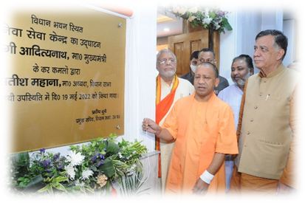
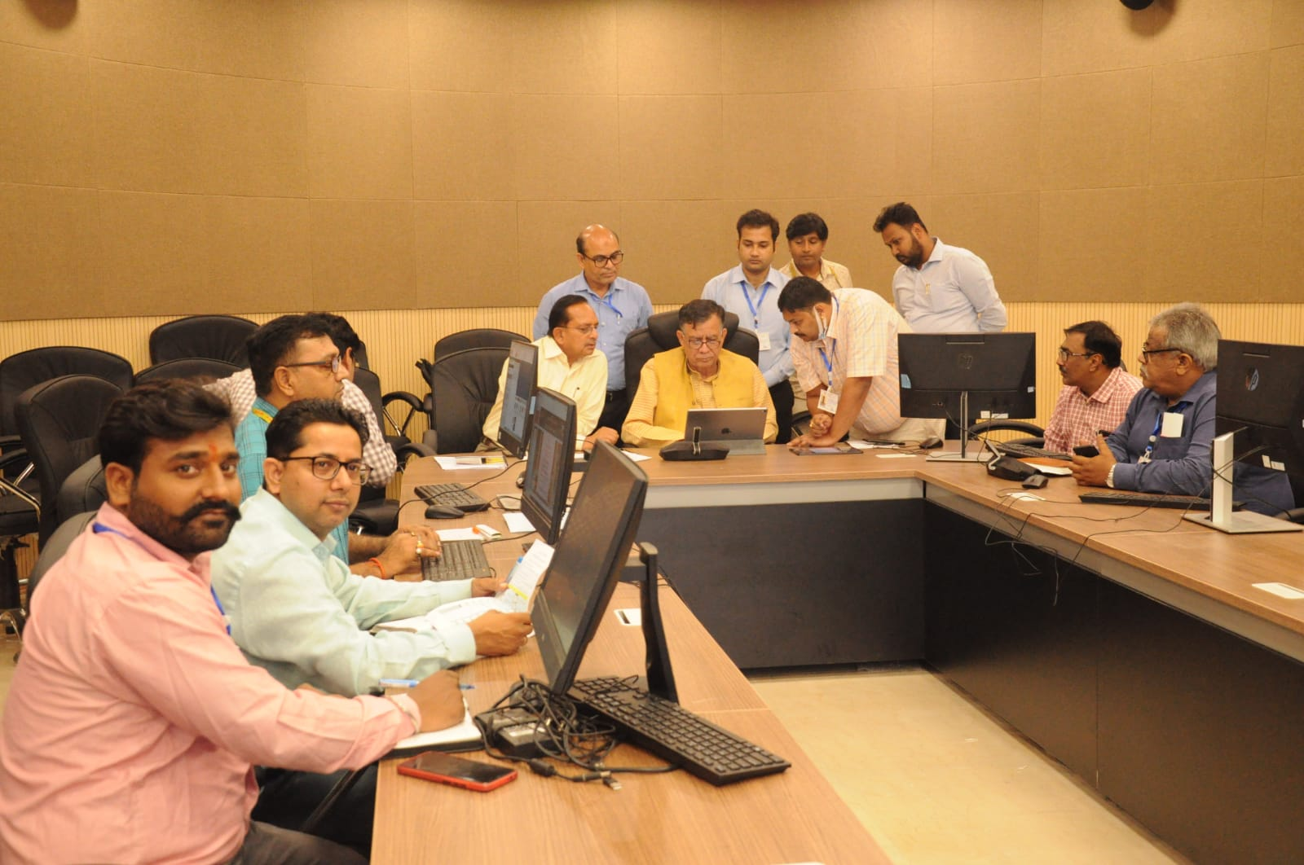
  NeVA Seva Kendra (NSK) For e-Facilitation
NeVA Seva Kendra Inauguration (19th May 2022) - The NeVA Seva Kendra was inaugurated on 19th May 2022, by the Hon'ble Chief Minister of Uttar Pradesh, with other dignitaries.

Slide 8
NeVA Implementation Status at UPLA
To make Proceedings of House Paperless, Tablets were installed on each desk in the house with provision of a metallic stand and shield/casing around them, to make them more resilient and sturdy.
A specific seat was allocated to each member with a visual touch device on the desk.
Optical fibre based High speed Network with Wi-Fi has been setup.
All the documents in the house are being laid in digital form through NeVA e-Book.
Following documents are being Laid through NeVA e-book.
  List of business (Agenda)
  Circular
  Budget Presentation
  Question/Answer
  Bills and Notices contd…

Slide 9
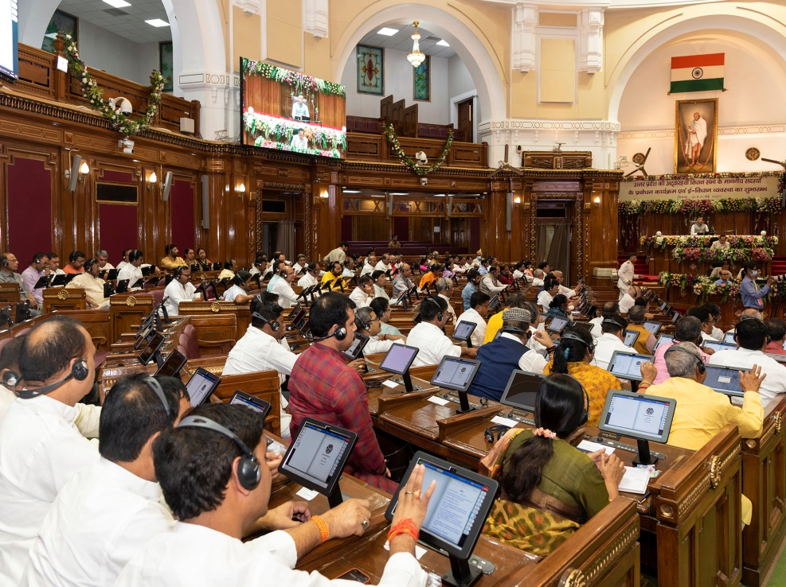
For Training of members Neva Seva Kendra Has been setup with all Modern facilities of communication including large display system, sound system and it’s backup there upon.
Neva Seva Kendra is also equipped with video conferencing facility.
Members were individually provided with tablets for digital working on NeVA.
Qualified Technical Manpower has been engaged to facilitate NeVA working as per the terms and condition mentioned in DPR.

Slide 10
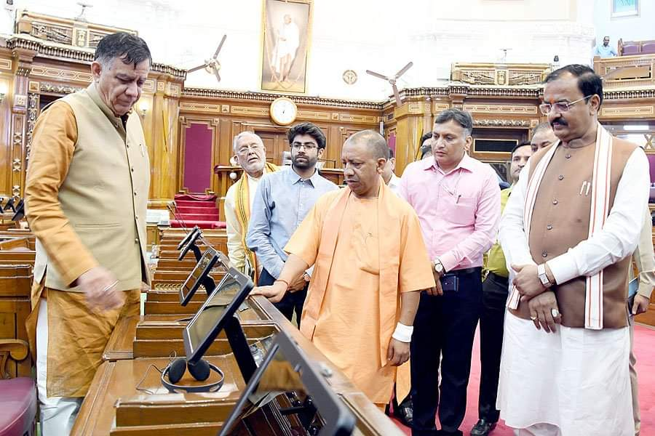
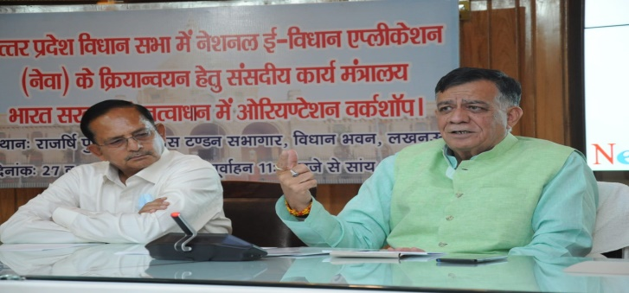
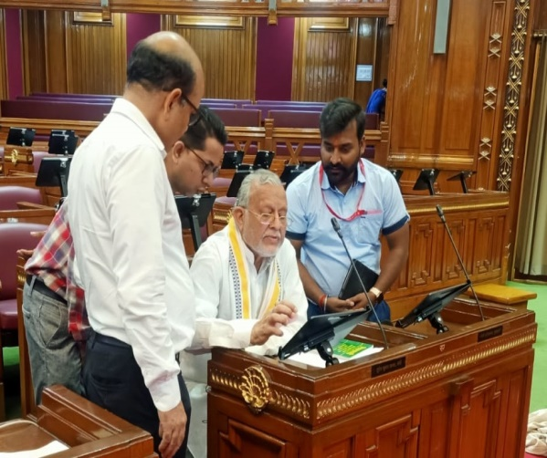
Glimpses of Training and Orientation Program on e-Vidhan
Training of Hon’ble Speaker and Members of the UPLA (20th to 21st May 2022).
The members of the Legislative Assembly were given a hands-on training session on the use of Tablets and e-Books.

Slide 11
NeVA- Services Status
S.No. | Proposed Services
1 | Digital House
2 | Business Controlling
3 | Reporters Branch
4 | Synopsis Branch (Proceeding Section)
5 | Editorial Branch (Proceeding Section)
6 | Table Office (Parliamentary Section)

Slide 12
S.No. | Proposed Services
7 | Question
8 | Members Secured Portal
9 | Bills Management
10 | Constituency Management
11 | Legislation (Parliamentary)
12 | Committees
13 | Member Amenities (MA) (Protocol)
14 | Members Salary and Allowances (MSA) (Accounts)

Slide 13
S.No. | Proposed Services
15 | Procurement and Stores (Index, Stationary Management )
16 | Digital Archives (Proceeding)
17 | Library
18 | Government Assurances
19 | Mobile APPs
20 | e-office implementation
21 | Public Portal
22 | User Management
23 | Centralized Pass Cell
24 | Media Desk

Slide 14
Future Road Map
UPLA suggestions :-
To customise NeVA features as per the requirement of UPLA.
Activation of NeVA for online information of Question-Answer/Notices/Bill from Government department.
Configuration of UP Legislative software with NeVA so that Bill Management, Constituency Management, e-Office implementation, is made effective.
Provision of Tablets in committee halls for conducting meetings online and in NeVA Seva Kendra for training purpose.
                contd…

Slide 15
Cyber security equipment like firewall, UTM, and managed switches may be approved to enhance security and creation of redundant backbone.
Each Legislative assembly has its own peculiarity so to become paperless we need to improvise NeVA to make it compatible with the existing digital infrastructure of the State Assembly.
The requirement of UP Vidhan Sabha is on higher scale considering the higher strength of members as compared to other states hence DPR must be revised considering the additional requirement of Hardware and Software for successful implementation of NeVA in Uttar Pradesh Vidhan Sabha.

Slide 16
THANK YOU

