Slide 1
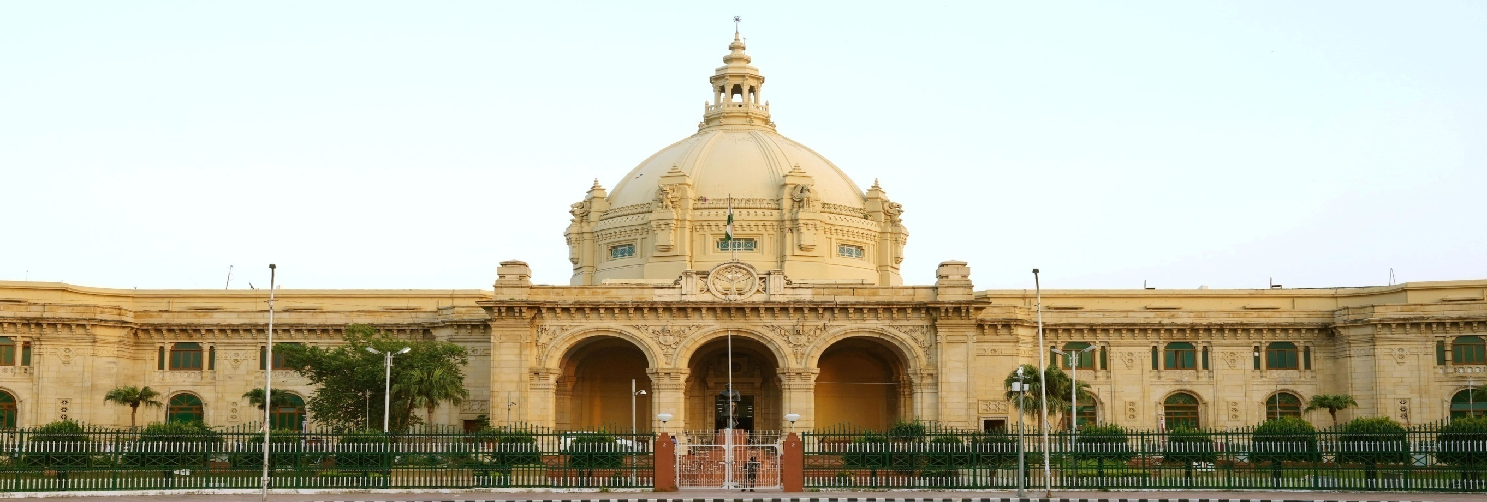
NeVA Implementation in
Uttar Pradesh Legislative Council

Slide 2
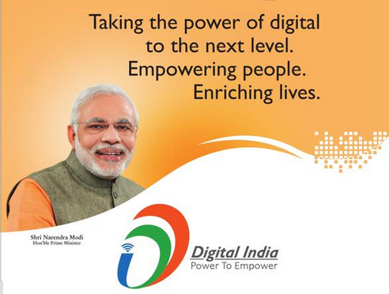
Concept of One Nation-One Application
A real time detail of the working of all the houses should be available to the common citizen and also to all the houses of the country. For this a modern digital platform has been developed in the form of “National e-Vidhan Application”
Shri Narendra Modi
Hon. PM Of India

Slide 3
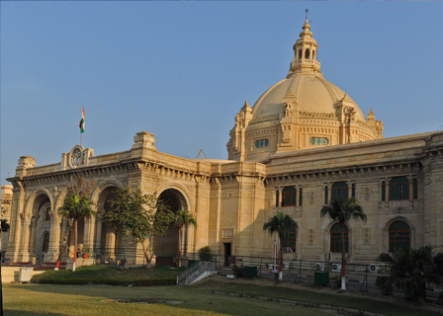
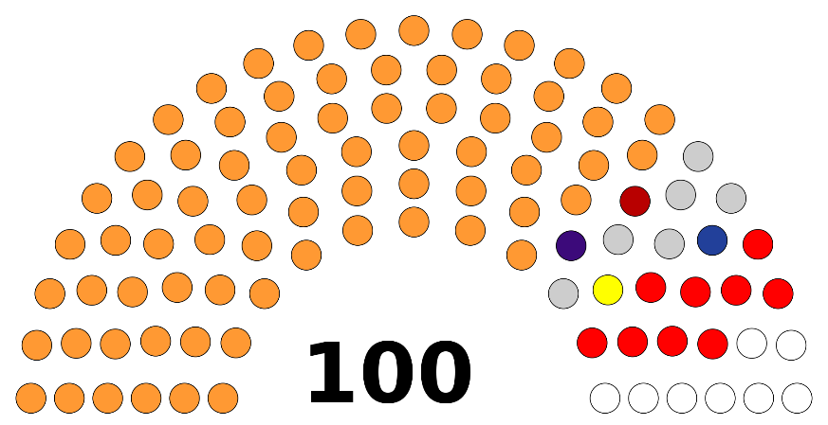
About Uttar Pradesh Legislative Council
The State of Uttar Pradesh has a bicameral legislature comprising of Legislative Council, an Upper House and Legislative Assembly, the Lower House. This is the largest legislature in India.
The Uttar Pradesh Legislative Council (Uttar Pradesh Vidhan Parishad) is the upper house of the bicameral legislature. This is a permanent house, consisting of 100 members.

Slide 4
Mission and Achievements
Mission-
The mission of e-Vidhan MMP is to make all the States/UTs Legislatures as paperless legislatures, streamlining all the processes for information exchange with the different State Government Departments and to publish the contents on the public portal as it happens. It also aims to assist the Members of the State/UTs Legislatures to use the latest ICT tools for preparing themselves for participation in the legislative debates more effectively.
Acheivements-
NeVA Seva Kendra (NSK) has been established.
Tablets/Touch Pads & Large Size Display Panels have been implemented to facilitate businesses of the House using NeVA Software.
NeVA Command Unit has beesn established.
VC Studio System has been established.

Slide 5
Digital Structure before NeVA
The UPLC has already computerized many of its activities / functions before the adoption of NeVA-
(“Go-Green” Solutions of UPLC saves about 100 million sheets of paper every year)
  Vidhan Parishad Online Prashnottar Pranali (UPVPQA) – UPVPQA have following different applications which are tightly linked together:
        Question Management System (QMS)
        MLC Online
        Online Answering System (OASYS)
        Public Interface for Vidhan Parishad
  Dynamic Web Portal of U.P. Vidhan Parishad
    Digitization of Proceedings
    First Paperless Budget in the State Assembly on 22.02.2021
    E-Office

Slide 6
NeVA Implementation Status at UPLC
Almost all the Activities & Procurement have been done according to the NEVA Guidelines & approved DPR.
NeVA Sewa Kendra (NSK) has been established.
All the procurement has been carried out through UPDESCO.
Deployment of Outsourced Manpower is in process as per guidelines.
GAP Analysis & Modifications in NeVA Software by MoPA Development Team is in progress to customize the NeVA Modules as per UPLC.
18 out of 38 Modules of NeVA successfully implemented, rest will be implemented after their customization by MoPA Team.

Slide 7
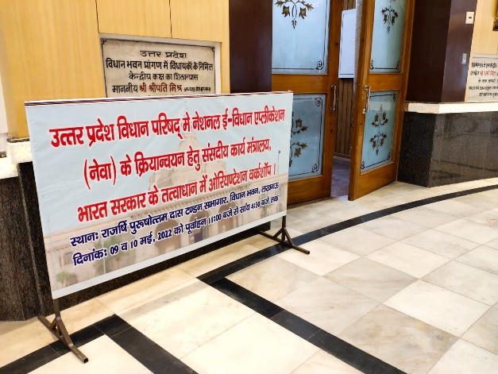
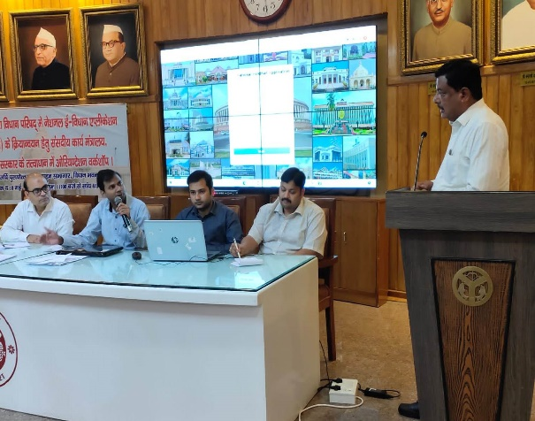
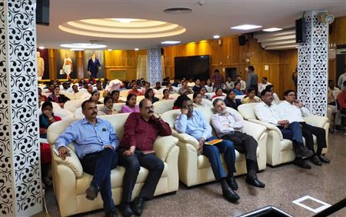
Historic Event- NeVA Workshop
NeVA Orientation Workshop (09th may 2022 to 10th may 2022) - The orientation and training sessions were conducted through NEVA platform under the guidance of Hon’ble Chairman of the Uttar Pradesh Legislative Council.

Slide 8
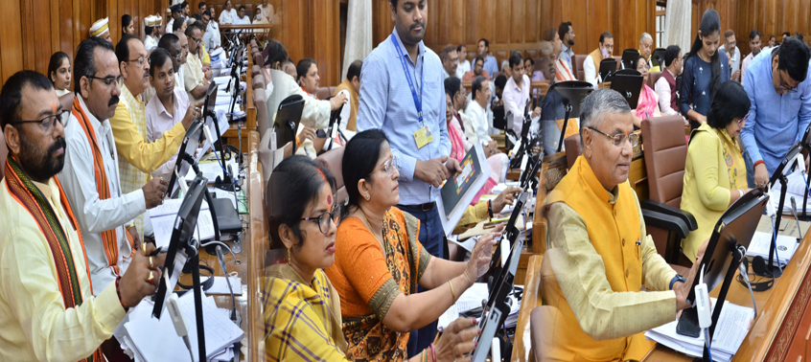
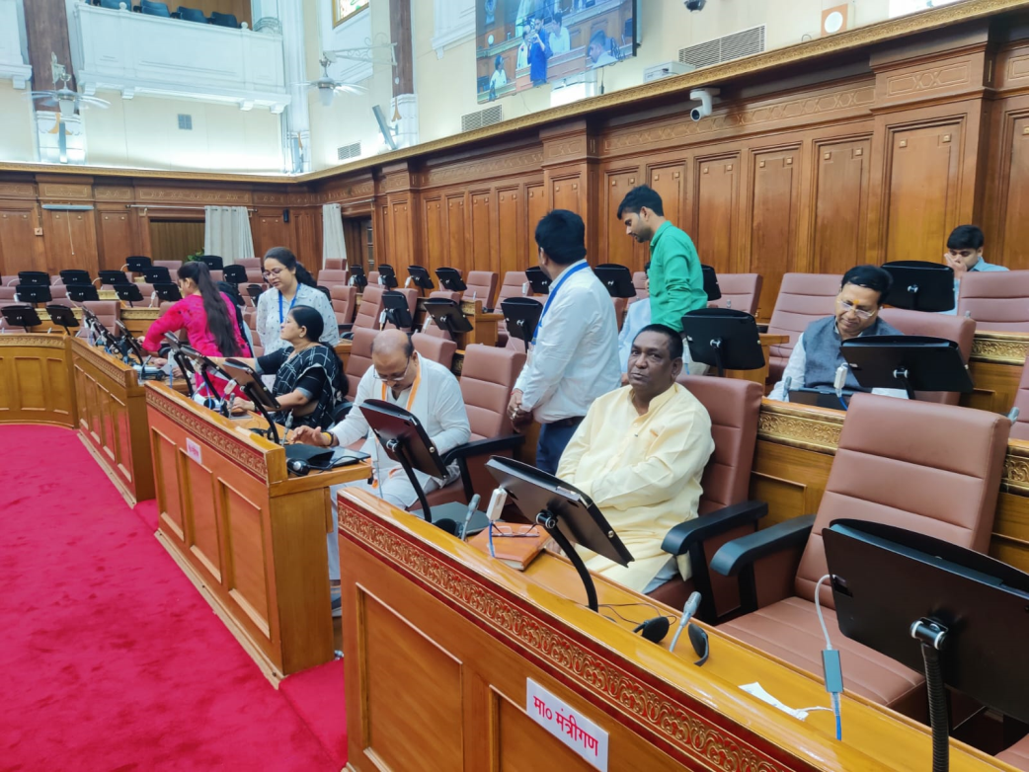
Historic Event – Hon. Members Training
Training of Hon’ble Chairman and Members of the UPLC (17th and 18th Sep 2022) - The members of the legislative Council were given a hands-on training session using tablets and e-books.

Slide 9
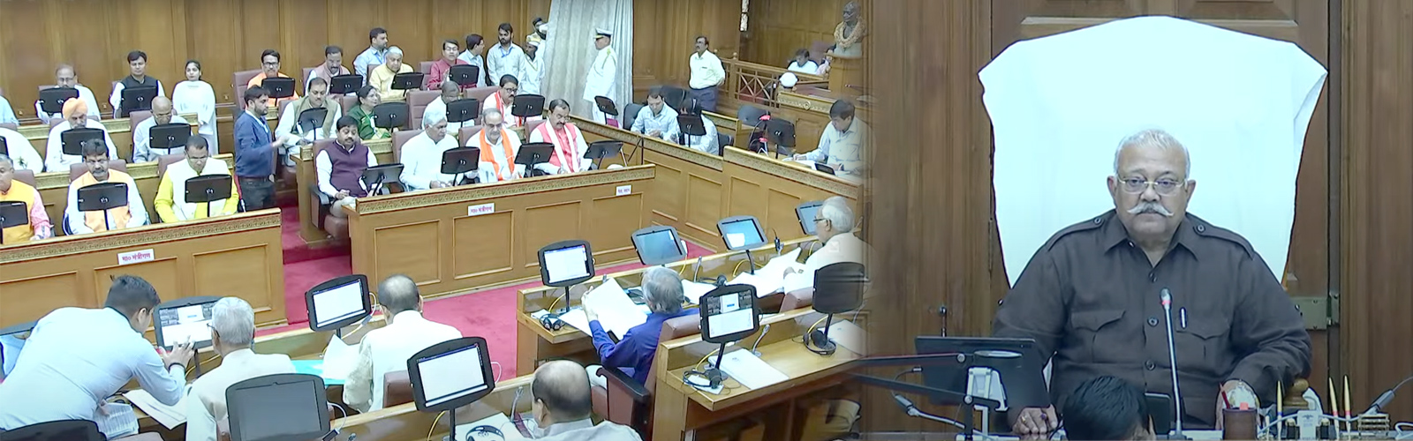
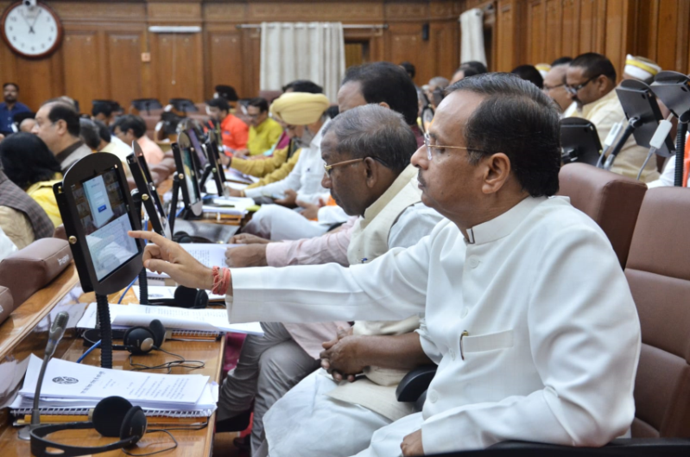
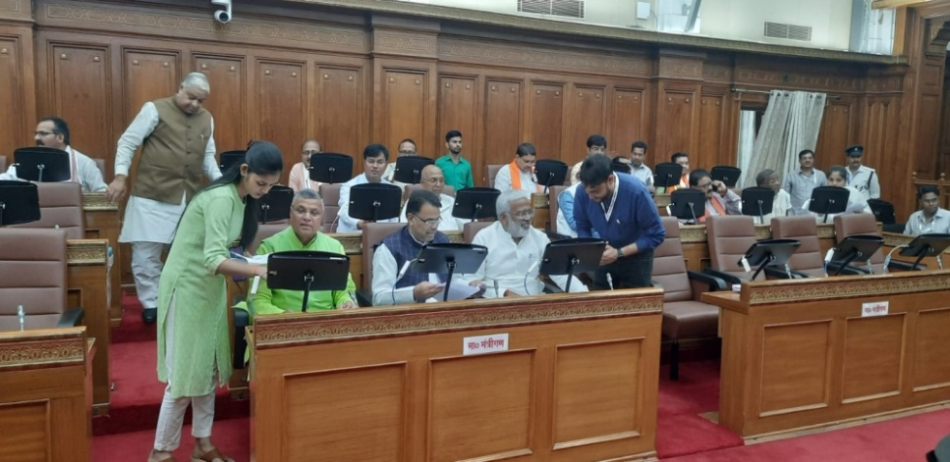
Historic Event - House Proceedings
Second Session of the Legislative Council 2022 - The second session of the legislative council was conducted smoothly for the first time with the help of the NeVA platform, by Hon. members accessing the legislative papers and documents on their tablets using the NeVA e-Book app.
Successive Sessions:
Third Session of 2022
First Session of 2023

Slide 10
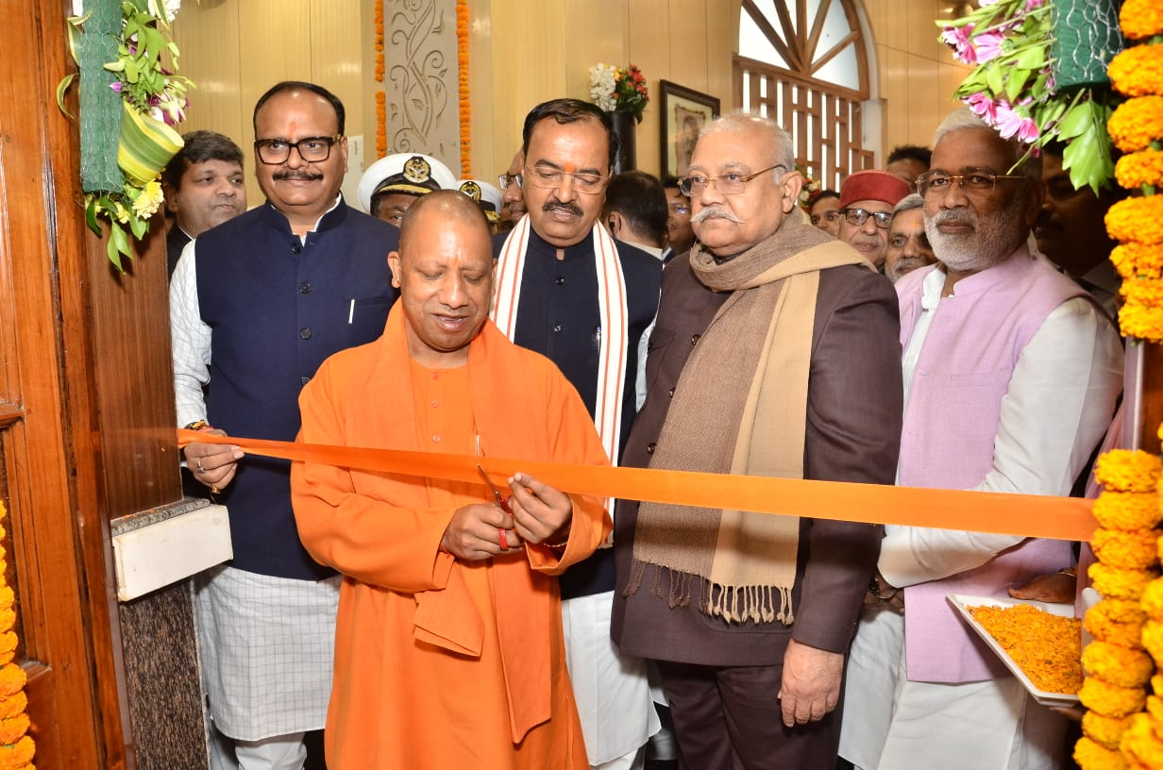
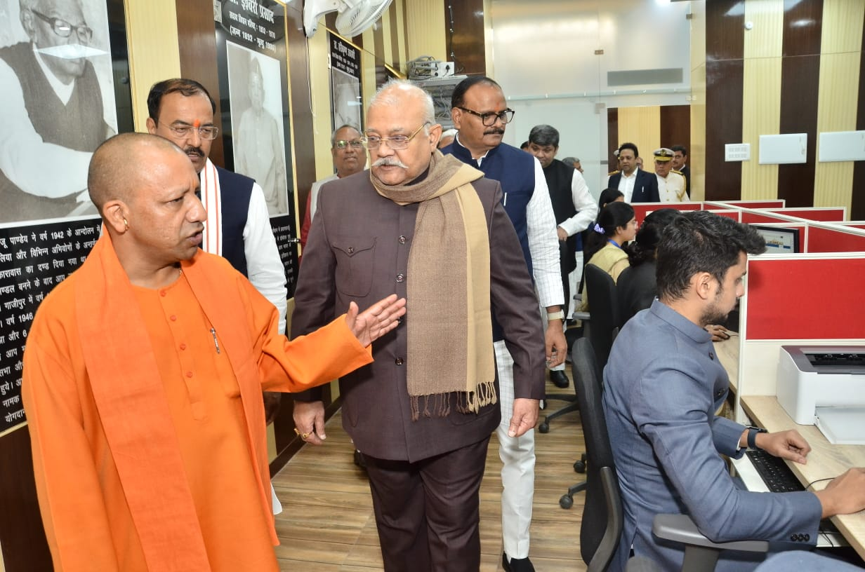
Historic Event- Inauguration
NeVA Sewa Kendra Inauguration (05th Dec 2022) - The NEVA Sewa Kendra was inaugurated on 05 Dec, 2022, by the Hon'ble Chief Minister of Uttar Pradesh, along with various other Dignitaries.

